Slide 1
CMPE 220
Class 21 – Frameworks
Notes:
Let’s talk about history.
California State Railroad Museum – 1976 - docents worked on original steam engines.

Slide 2
Types of System Software

Slide 3
Building Software
High Level Language Source Code (e.g. C++)
Assembly Language Source Code
Binary Machine Code
Compiler
Assembler
optional
Executable
Machine Code
In-Memory
Code
Linker
Loader
Hardware Execution

Slide 4
Additional Development Tools
Cross-Development Tools
Emulators
Integrated Development Environments (IDEs)
Debuggers

Slide 5
Servers and Services
Servers
Web server
DNS server
FTP server
Email server
Database server
Web application services
Windowing systems
Protocols
IP – Internet Protocol
TCP/IP
UDP
FTP
SMPT
IMAP
POP
MySQL

Slide 6
Operating Systems
OS Functions
Process Management
Interprocess Communications
Input / Output (I/O) Management
Memory Management
File System Management
System Functions and Kernel Mode
User Interaction – (maybe)
Networking

Slide 7
OS Types
Traditional Operation Systems
Distributed Systems
Networked Operating Systems
Object Oriented Systems
Virtual Systems

Slide 8
Frameworks

Slide 9
What is a Framework?
A software framework used by software developers to implement the standard structure of application software
A library
A set of object classes

Slide 10
Pros and Cons of Frameworks
Pros
A proven architecture
Built-in functionality
Developer communities
Cons
Performance penalty
Potential obsolescence

Slide 11
Early Frameworks
Xerox PARC / SmallTalk – mid-70s?
MacApp – 1985
Microsoft Foundation Classes (MFC) – 1992
ColdFusion (web application framework) - 1995

Slide 12
Types of Frameworks
GUI Application Frameworks
Web Application Frameworks (server)
Web Application Frameworks (client)
Mobile Application Frameworks (iPhone / Android)

Slide 13
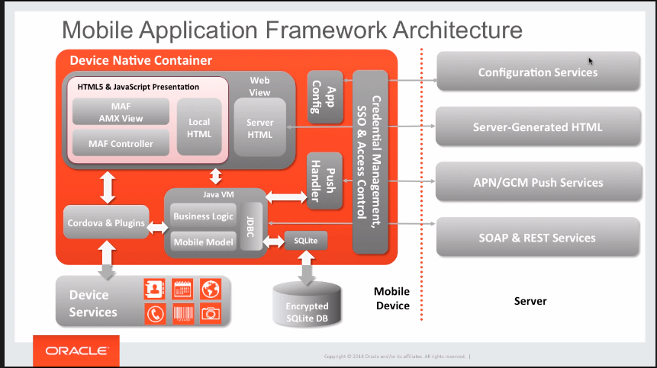
System Software?

Slide 14
Development Using Frameworks
The framework consists of a set of object classes
To write applications, developers subclass the framework classes, and override their methods
Most frameworks use a Model-View-Controller (MVC) architecture
Top-level class is the App
Override the init method to set up the application
Create other objects used by the app
Register callbacks

Slide 15
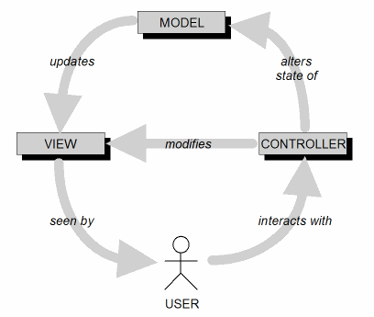
Model-View-Controller Architecture (MVC)
MVC is an ideal architecture for GUI applications.
Design goal: Identify which application components are model, view, or controller.
A user cannot directly modify the model.

Slide 16
MVC Implementation: Loose Coupling
Keep the implementations of the three object types separate.
Each type of objects does not depend on how the other types are implemented.
Your application is
easier to develop and maintain
faster to develop
more robust (resilient to runtime errors)

Slide 17
MVC Model Objects
Represent the persistent information maintained by your application.
State
The information can be kept in a database.

Slide 18
MVC View Objects
View objects represent user interface components.
Input components such as text fields and checkboxes.
In each use case, users interact with at least one view object.
A view object collects information from users in a form that the model and controller objects can use.

Slide 19
MVC Controller Objects
Coordinate the model and view objects.
Often have no physical counterpart in the real world.
Collect information from view objects for dispatch to model objects.
This is how user-entered data can update the model.

Slide 20
Advantages of MVC Architecture
Classes are Cohesive
Classes are Loosely Coupled
Principle of Information Hiding
Functionality and data are Encapsulated
Changes are isolated and localize
Provides a clear separation of business logic, Ul (display) logic, and input logic.
Each component can be tested separately

Slide 21
Model-View-ViewModel (MVVM)
MVVM is an architectural pattern, invented by Microsoft architects Ken Cooper and Ted Peters
MVVM (Model-View-ViewModel) cleanly separates the business logic of an application from the user interface
The ultimate goal of MVVM architecture is to make the view completely independent from the application logic

Slide 22
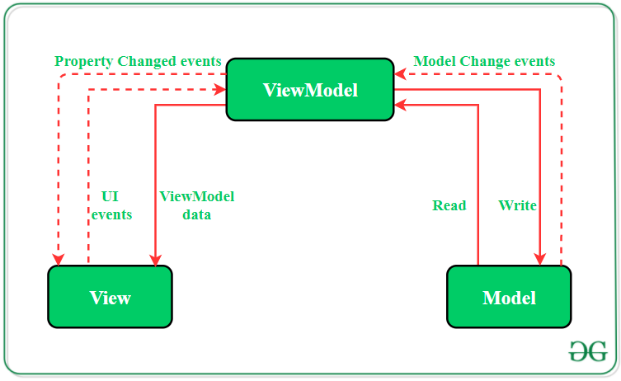
Model-View-ViewModel (MVVM)

Slide 23
Advantages of MVVM
MVVM has a unidirectional data and dependency flow
Dependency is one way, thus it is easier to decouple it needed

Slide 24
MVC versus MVVM
In MVC, the controller is the entry point to the Application
In MVVM, the view is the entry point to the Application
In the MVC Model, the Model itself serves as the mediator between the View and the Model
In the MVVM model, the ViewModel serves as the mediator between the View and the Model, and can have a one-to-many relationship with views Because the ViewModel is responsible for exposing the data and logic of the Model to the View, it can be easier to test the ViewModel separately from the View.

Slide 25
Inversion of Control
The framework controls the execution flow
The developer registers callback functions, mostly as event handlers, with the framework
After initializing objects and registering callbacks, the developer surrenders control to the framework
The framework invokes the callback functions at the appropriate times, such as in response to events

Slide 26
Callbacks
Callback functions are registered to:
Process events
Button clicks
Menu selections
Timer events
Data Transformation
Validate
Filter
Format

Slide 27
Popular Frameworks
GUI / Windowing
Chromium (C/C++)
GTK (C/C++)
MKS (C/C++)
QT (C/C++)
wxWidgets (C/C++)
Apache Pivot (Java)
JavaFX (Java)
Swing (Java)
Bottle (Python)
Django (Python)
CherryPy (Python)
Flask (Python)
Web2Py (Python)

Slide 28
Popular Frameworks
Web Applications
Angular – JavaScript
CodeIgniter – PHP
Django – Python
Laravel – PHP
Rails – Ruby (aka RoR or Ruby on Rails)
Spring – Java

Slide 29
Popular Frameworks
Web Client Frameworks
Angular
Backbone.js
Ember
jQuery
React
Svelte
Vue.js

Slide 30
Popular Frameworks
Frameworks for Mobile Apps
Swiftic
React Native
Xamarin
Ionic
Mobile Angular
Onsen UI
Flutter
Corona (Solar2d)

Slide 31
Assignment 8
Securing a software service
You’ve developed a new software service. It will be accessible over the Internet, using accounts created by the users.
It will be hosted on a dedicated server that you manage.
The data handled by this service is very sensitive.
Write a short description of all the things you will do to secure your service.
Submit this assignment as a pdf file.
Due next Tuesday

